Slide 1
Credit
Data Overview
Takeshi Sugiyama

Slide 2
Agenda
Dataset overview
Tables
Demographics
Debt
Payment
Preliminary exploratory data analysis

Slide 3
Dataset overview
Credit risk dataset from Kaggle.
The data contains loan applicant information collected by a US credit bureau.
Each row represents a single loan application and the information gathered on the applicant at the time of the application.
Contains info of applicants demographic, debt, and payment history.
Data is hosted in Google Cloud SQL.

Slide 4
Tables - Demographic, Debt, Payment
Demographic
customer_id | Primary key
age | integer
monthlyincome* | float (dollars)
numberofdependents* | integer
Debt
customer_id | Primary key
debtratio | float (percentage
revolvingutilizationofunsecuredlines | integer
numberofopencreditlinesandloans | float
numberrealestateloansorlines | integer
Payment
customer_id | Primary key
seriousdlqin2yrs | True / False
numberoftime30_59dayspastduenotworse | integer
numberoftime60_89dayspastduenotworse | integer
numberoftimes90dayslate | integer
* Contains N/A values.
Data description

Slide 5
Preliminary EDA
EDA based on sample_data.csv batch
150,000 entries total
Monthly income and the number of depends were the only columns with missing values (29,731 and 3,924 counts respectively)
seriousdlqin2yrs (serious delinquency) is the target variable

Slide 6
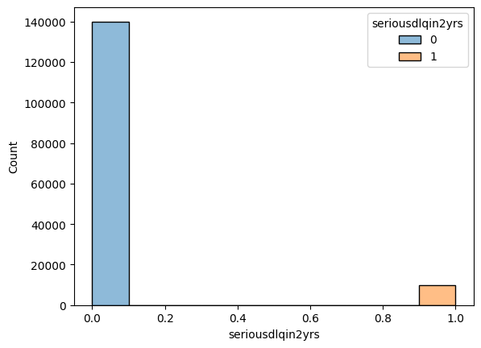
Serious delinquency distribution
True: 10,026 ( 6.7.%)
False: 139,974 (93.3%)

Slide 7
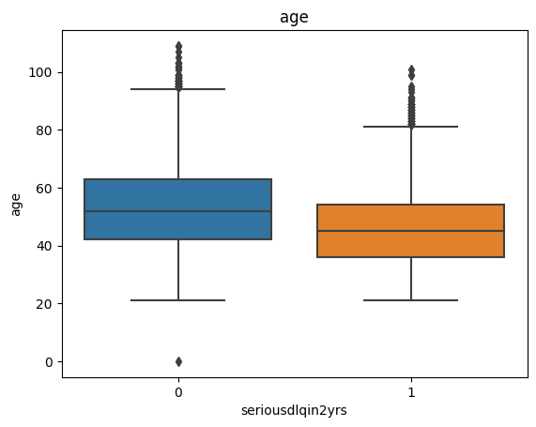
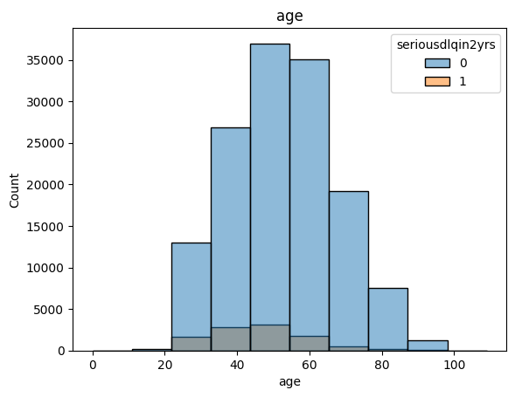
Age

Slide 8
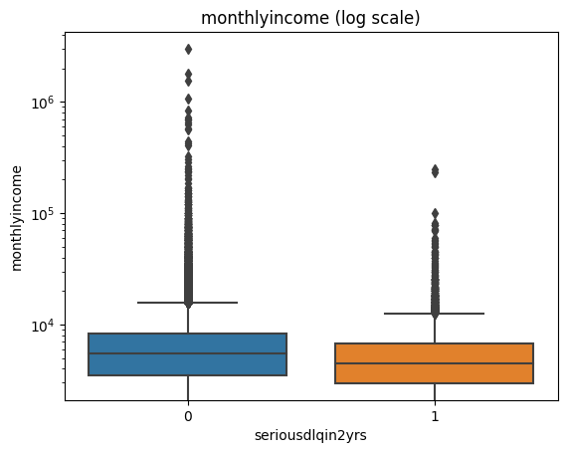
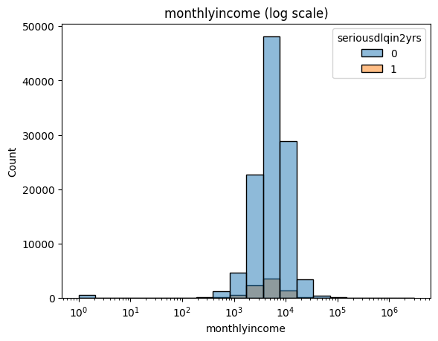
Monthly income (log scale)

Slide 9
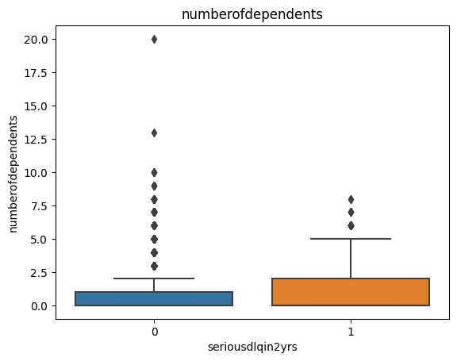
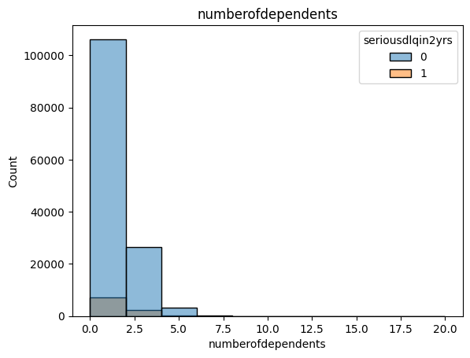
Number of dependents

Slide 10
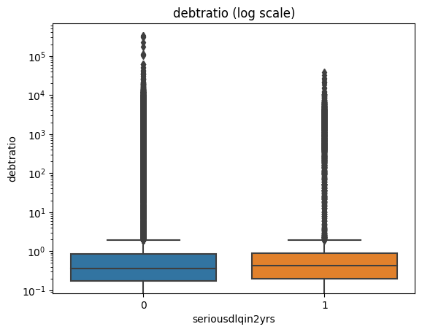
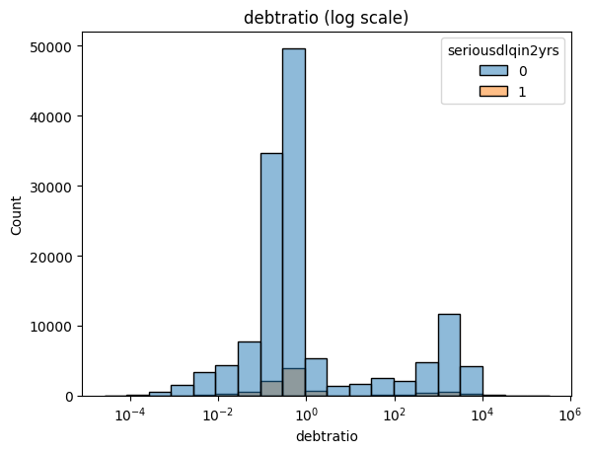
Debt ratio (log scale)

Slide 11
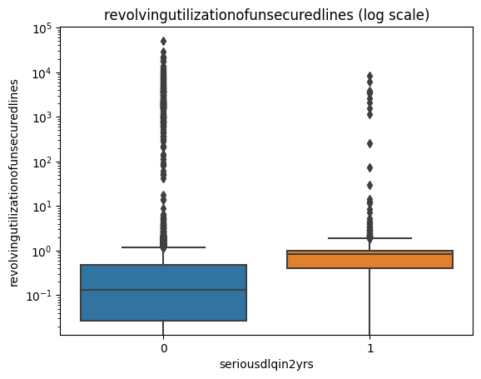
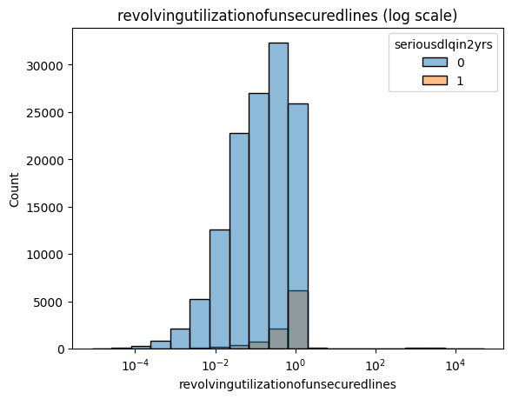
RevolvingUtilizationOfUnsecuredLines (log scale)

Slide 12
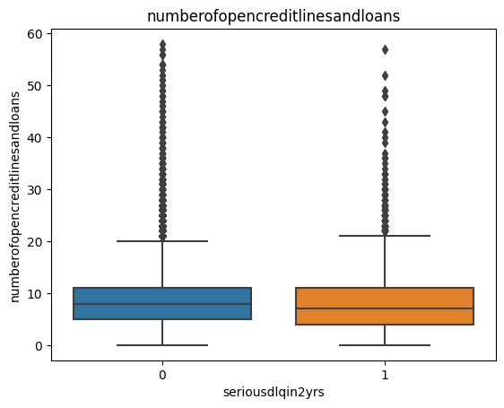
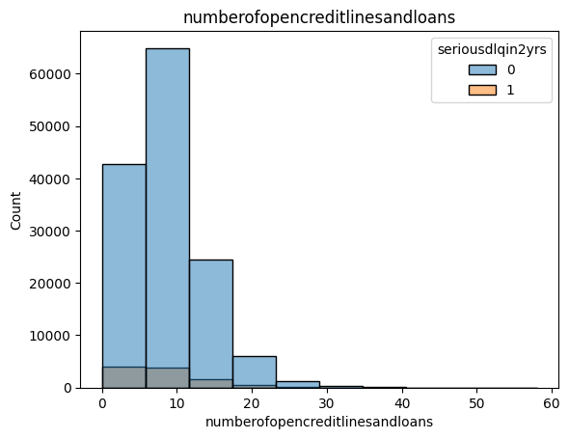
NumberOfOpenCreditLinesAndLoans (log scale)

Slide 13
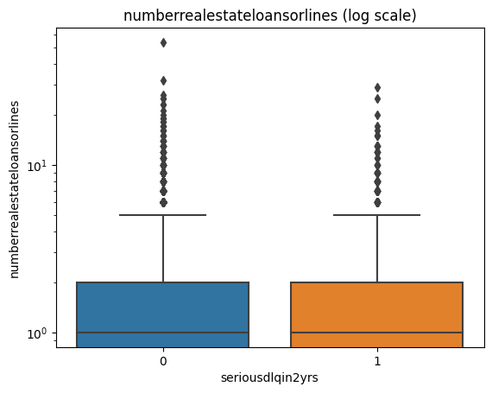
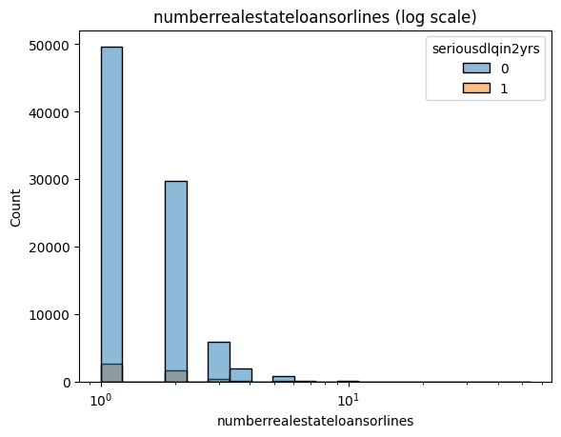
NumberRealEstateLoansOrLines (log scale)

Slide 14
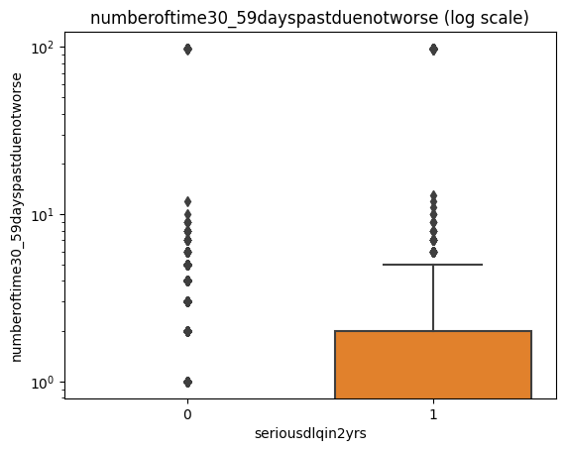
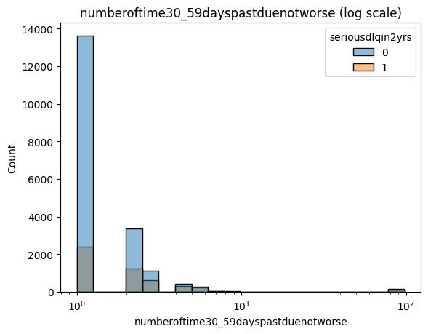
NumberOfTime30-59DaysPastDueNotWorse (log scale)

Slide 15
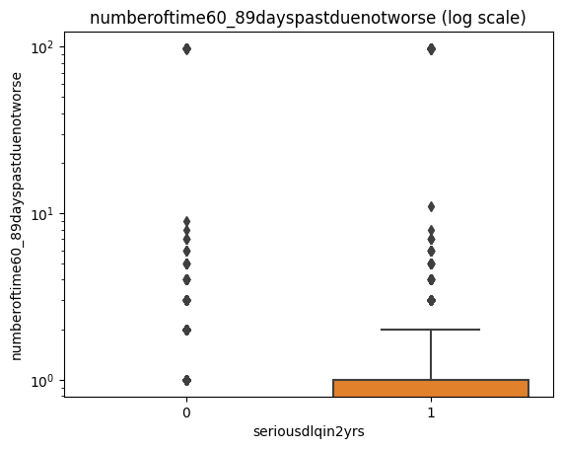
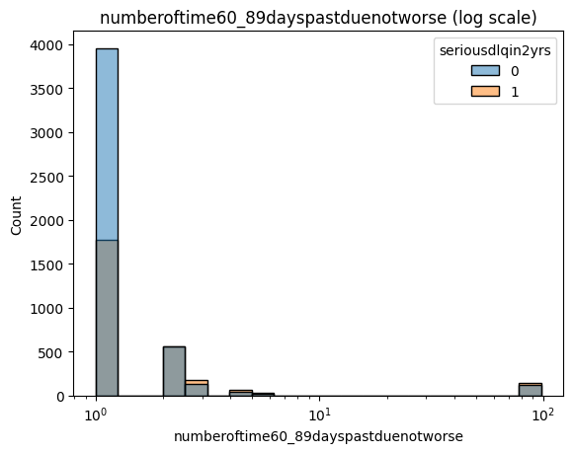
NumberOfTime60-89DaysPastDueNotWorse (log scale)

Slide 16
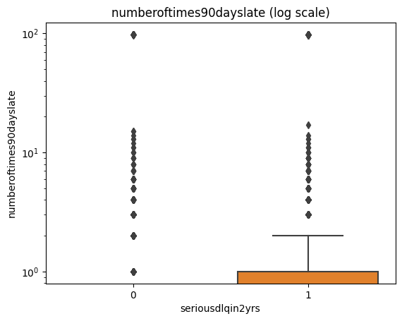
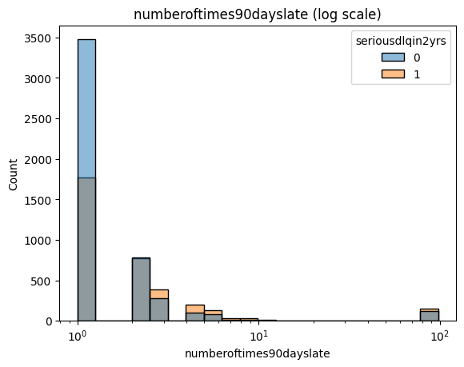
NumberOfTimes90DaysLate (log scale)

Slide 17
Pearson correlation coefficient for serious delinquency
Column | Coefficient
numberoftime30_59dayspastduenotworse | 0.13
numberoftimes90dayslate | 0.12
numberoftime60_89dayspastduenotworse | 0.10
numberofdependents | 0.05
revolvingutilizationofunsecuredlines | 0.00
numberrealestateloansorlines | -0.01
debtratio | -0.01
monthlyincome | -0.02
numberofopencreditlinesandloans | -0.03
age | -0.12

Slide 18
Appendix
Basic steps to access Google Cloud SQL is here.
Preliminary EDA notebook is located here.

